Slide 1
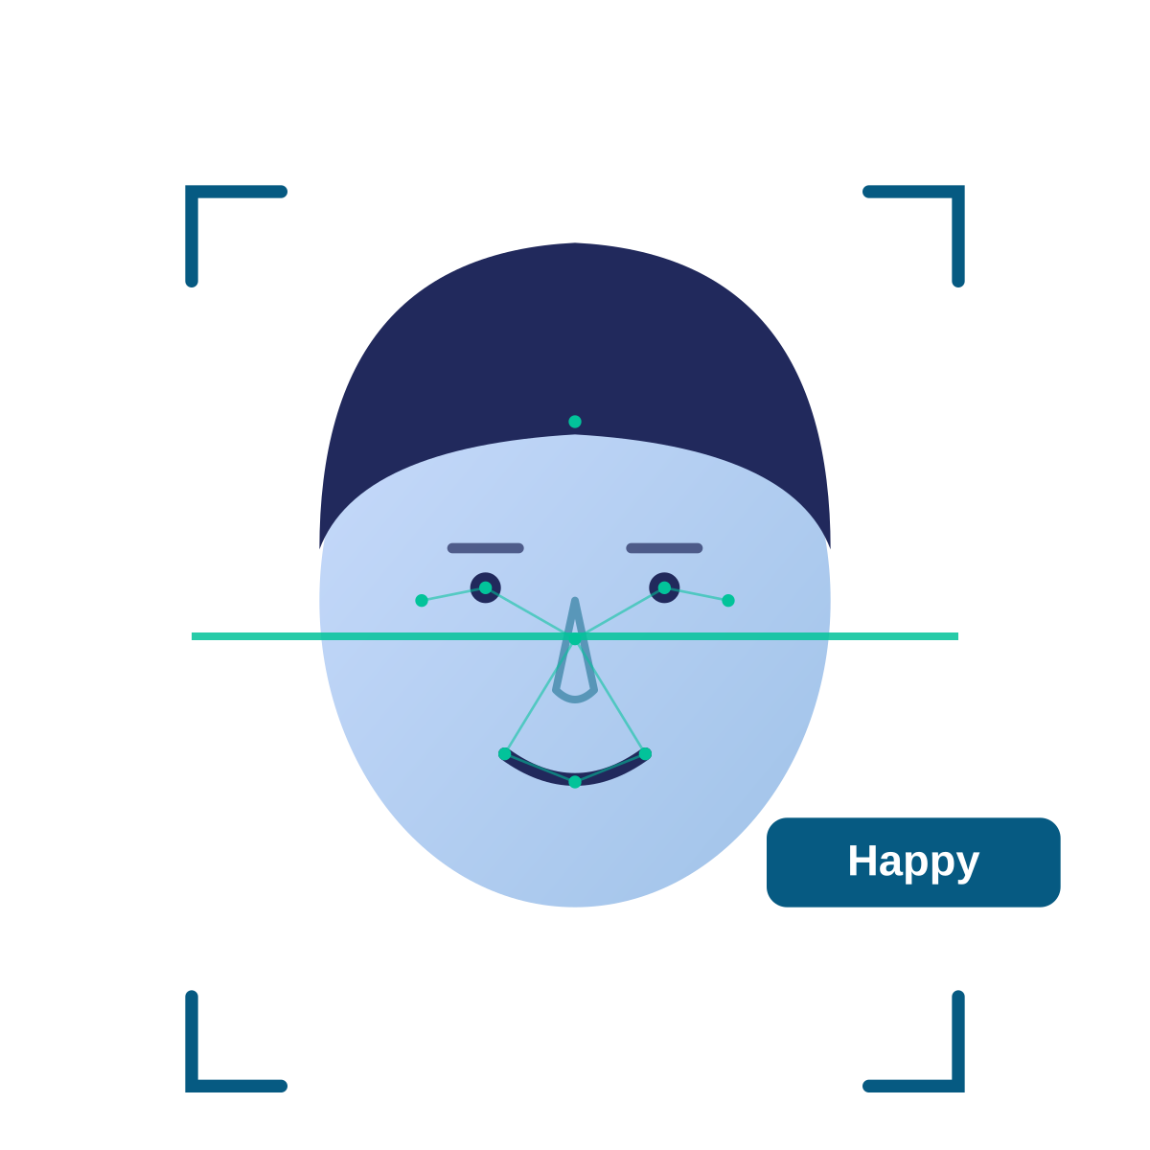
FACIAL EMOTION
DETECTION
Presented by: Mahi Jha and Vanshika Kandpal
MCA — NIT Warangal
Python Lab Project

Slide 2



Project Overview
Detects a human face from an image or webcam input.
Face Image
AI Model
The detected face is processed and given to a trained CNN model.
→
→
"Happy"
The model classifies the visible facial expression into one of seven predefined categories.
Example Prediction Pipeline
The prediction is displayed through a simple Streamlit interface.
Dataset: FER-2013
7 Expression Classes
Problem Being Solved
Manual interpretation of facial expressions can be subjective and difficult when many faces need to be analyzed. This project demonstrates an automated approach to facial-expression classification.
Angry
Disgust
Fear
Happy
Sad
Surprise
Neutral
Facial Emotion Detection Using CNN
2

Slide 3





Technology Stack & Project Flow
Technology Stack
Overall Project Flow
Python
PHASE 1 — TRAINING
PHASE 2 — PREDICTION
Core programming language
FER-2013 Dataset
Image / Webcam
OpenCV
▾
▾
Face detection & image processing
Image Preprocessing
OpenCV Face Detection
TensorFlow / Keras
▾
▾
CNN model development & training
CNN Training
Preprocessing
(Grayscale → Resize 48×48 → Normalize)
NumPy
▾
▾
Numerical & image-array processing
Trained CNN Model
Emotion Prediction
Streamlit
▾
User interface
Streamlit Display
FER-2013
Training / testing dataset
Facial Emotion Detection Using CNN
3

Slide 4

How the System Works
1
Image / Webcam Input
6
Normalize Image
Example
▾
▾
Detect Face
CNN Model
Input Face
2
7
▾
▾
▾
3
Extract Face
8
Predict Facial Expression
Image Processing
▾
▾
4
Convert to Grayscale
9
Display Result
▾
CNN Prediction
▾
5
Resize to 48 × 48
"Happy" — predicted expression
The input face is converted into a consistent format before being passed to the trained model. The model then predicts the most likely facial-expression category.
Facial Emotion Detection Using CNN
4

Slide 5


Limitations & Future Scope
Limitations
Future Scope
Poor lighting can affect face detection and prediction.
Improve the CNN model and training process.
Side-facing or partially hidden faces may reduce performance.
Use data augmentation and hyperparameter tuning.
Masks, glasses, or hands can hide important facial features.
Support multiple faces in a single frame.
Similar facial expressions can be difficult to distinguish.
Improve real-time webcam performance.
Performance depends on the quality and diversity of the dataset.
Deploy the application as a web-based system.
Facial expression does not always represent a person's actual emotion.
Evaluate the model using accuracy and confusion matrix.
Goal: Build a lightweight and accessible facial-expression classification system.
Facial Emotion Detection Using CNN
5

